Slide 1

A survy on Heap Exploitation
Presenter : Alireza Karimi
Advisor : Giovanni Lagorio
Examiner : Alessandro Armando
Base on the glibc heap implementation

Slide 2

Table
What we talk about
Introduction
Glibc Heap
Exploitation
RealWorld
Conclusion

Slide 3
Introduction

Slide 4
Memory
Heap or Stack that is the question
Memory Space type
Stack
Heap
Heap or stack?

Slide 5
Glibc Heap

Slide 6
Glibc
What is that?
GNU C library
Memory Allocation
Malloc() , Free()

Slide 7
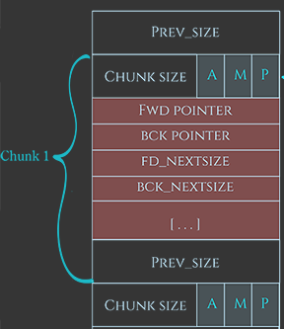
Chunk
First things first
Smallest Allocation
A data structure
Metadata alongside user data
Different structure when freed

Slide 8

Bins
The lists to rule them all
How to keep track of freed chunk
Single list?
Performance
Keep in different list
127 list+Fast bins+Tcache bins

Slide 9
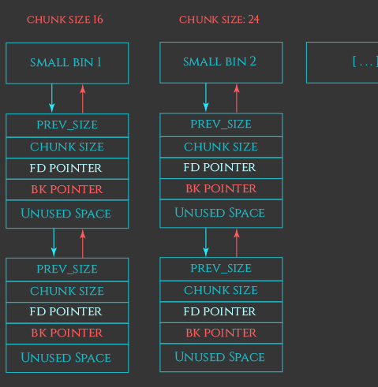
Small Bins
62 list
Same fix size each
Double link list

Slide 10
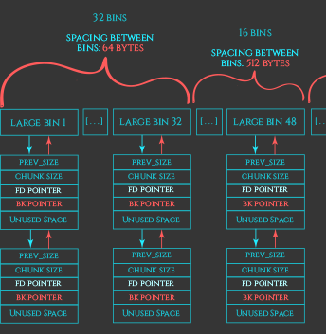
Larg Bins
Over 512B in 32bit
Over 1KB in 64Bit
63 Lists
Double link list
Size is in a range
Need to manually sort
Slower than small bins

Slide 11
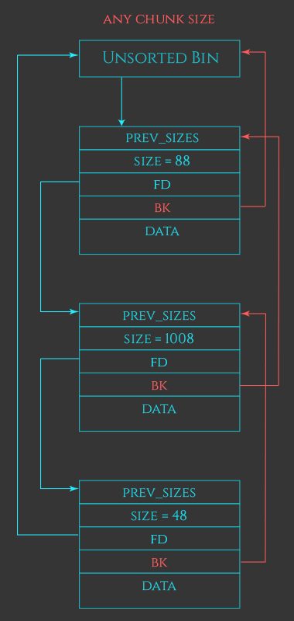
Unsorted bin
1 List for optimization
Merge freed chunk
Any size
Unlike others , Can split chunk

Slide 12
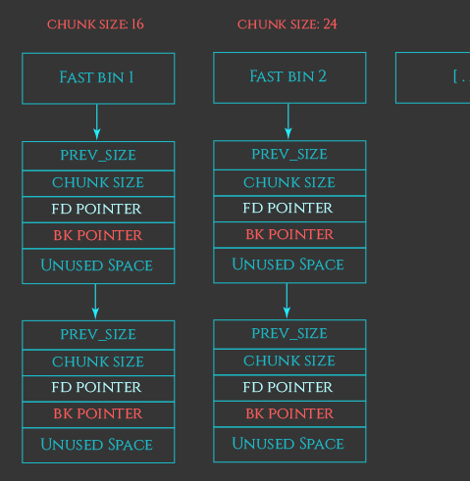
Fast Bins
First Optimization
Single link list
Keep chunks alive
Dont merge chunks
10 lists, single size
Need flush memory after a while

Slide 13
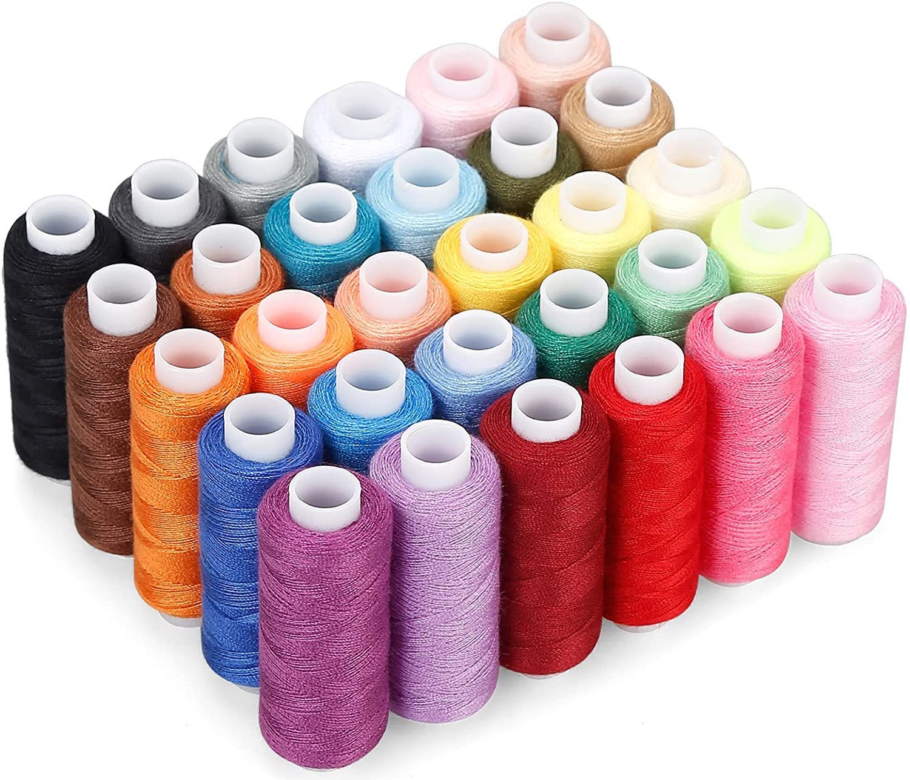
Tcache
Second Optimization
Per-Thread
Added since Glibc-2.26
Avoid Lock and race condition
First place to search
64 list
7 chunks same size each

Slide 14
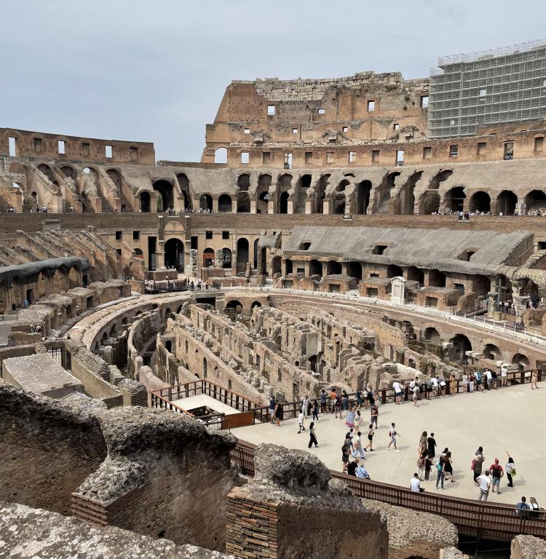
Arena
A place to keep them all
Main heap
Multi-thread
Still have mutex lock

Slide 15
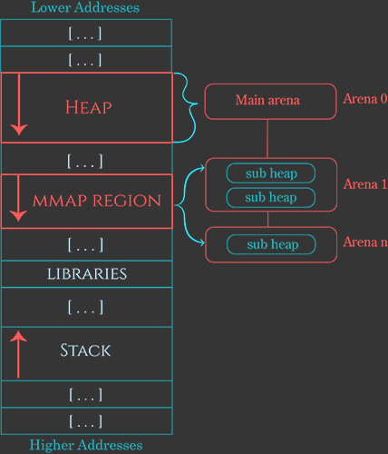
Subheap

Slide 16
Allocation
In a simple algorithm
Allocation from previously free chunks
Allocation from the top chunk
Asking for more memory

Slide 17
Malloc()
I need memory
Depends on heap implementation
Which version of Glibc?
Single thread or multi-thread?

Slide 18
Malloc()
Where?
Tcache bins is first place
Lock the arena if need
Check the fast bins and fill tcache
Check the small bins and fill tcache
Consolidate fast bins
Check unsorted bin
Move unsorted bin’s chunk to small/large bins
Check large bins
Top chunk
Mmap

Slide 19
MMAP
I need much more
Large amount of memory
Chunks metadata has a flag for it
Start from 128KB, then, grow to 512KB

Slide 20
Calloc()
Clean it for me
Zero-out
NO Tcache!

Slide 21
Free()
Do not need anymore
Calculate chunk address from user data section
Check mmap flag
Check size and alignment
Tcache is first
Fast bins?
Merge with neighbours in Small/Large bins
Merge with the top chunk

Slide 22
Alignment
Need order
16 byte Alignement
Return aligned chunk
Check alignment in free(

Slide 23
Exploitations

Slide 24
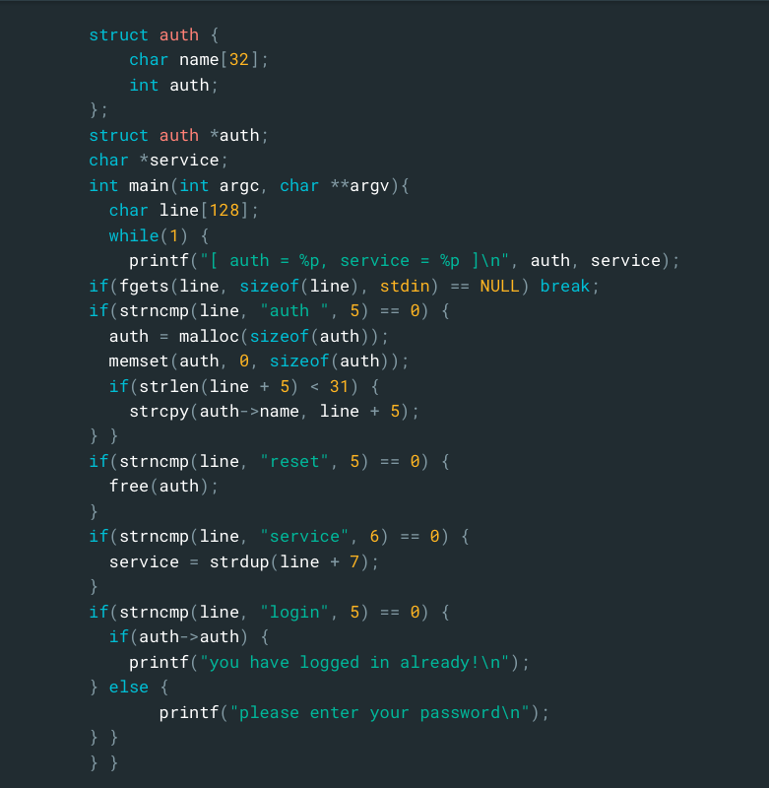
Use After Free
It is still there
Use a chunk after free

Slide 25
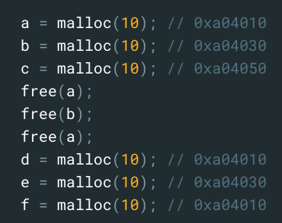
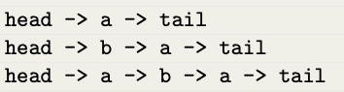
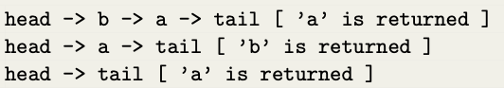
Double Free
It is already free
Allocate 3 chunk of date
Release one of them twice
Fast bins can detect memory corruption if we free same chunk twice in a row
We have to bypass security check by free a second chunk in the middle
Glibc 2.23

Slide 26
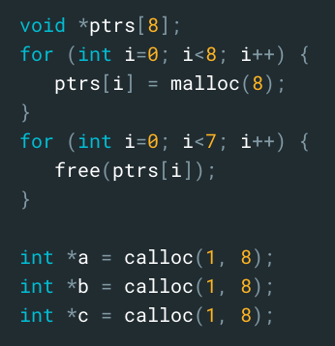
What about tcache?
Fill it first
Use calloc instead of malloc

Slide 27
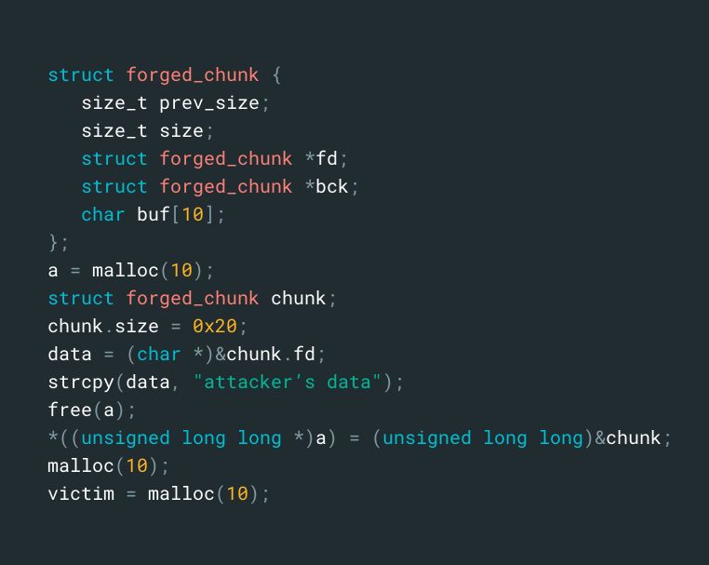
Forged Chunk
Return my location
Use a pointer to free chunk to manipulate heap structure
Create a fake chunk where every we want like stack
Fast bin has security check on chunk size
Modify the forward pointer of free chunk (UAF)
Remove free chunk from top of list
Next allocation return our forged chunk

Slide 28
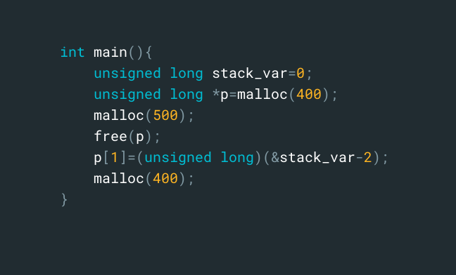
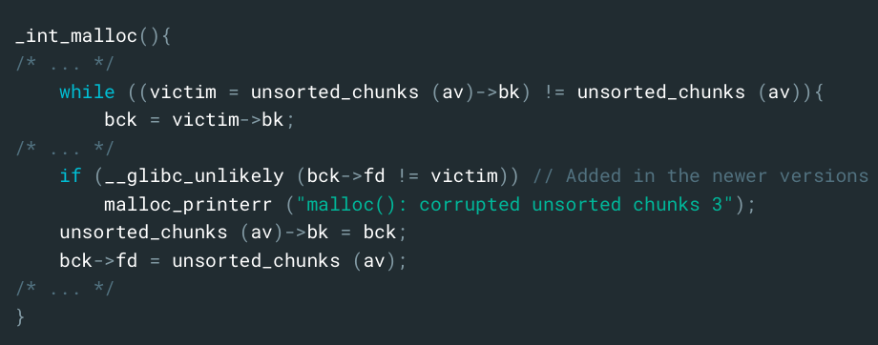
Unsorted bin attack
Write somewhere
Glibc 2.23
Abuse bk pointer
We don’t have control over data
We can control location
Useful for ASLR

Slide 29
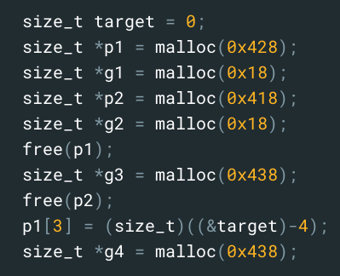
Large bin attack
Last resort
Still work
Write data on a controlled location

Slide 30
The houses

Slide 31
‘It is for this reason, a small suggestion of impossibility, that I present the Malloc Maleficarum’
The Malloc Maleficarum

Slide 32
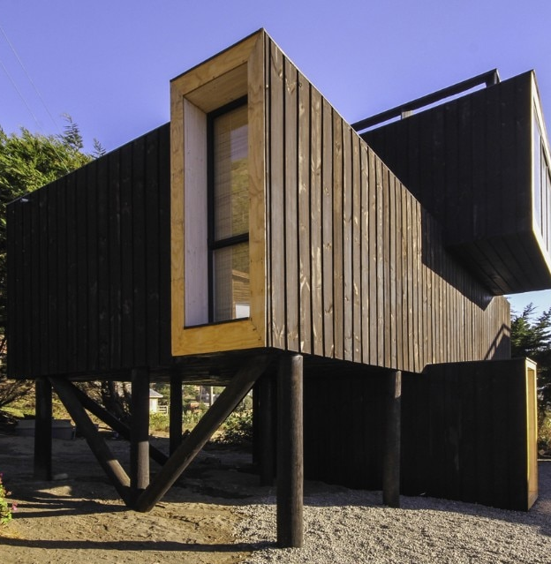
The houses
The original ones
The house of mind
The house of prime
The house of spirit
The house of force
The house of lore
The house of underground

Slide 33
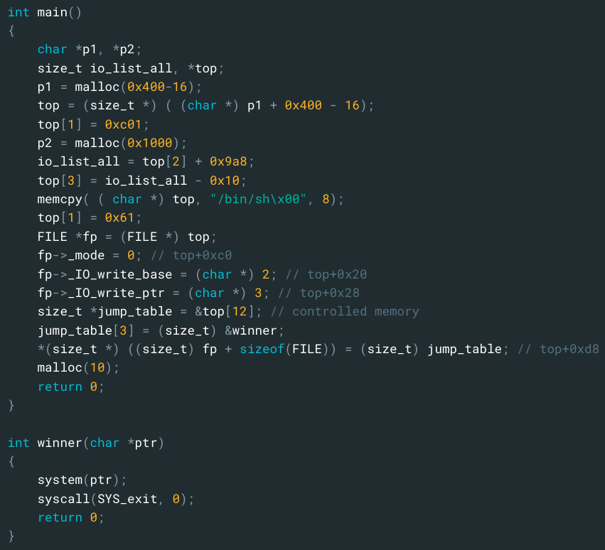
House of Orange
hitcon-ctf-2016
Combination of different attack
The POC file want to gave shell access

Slide 34
RealWorld

Slide 35

Sudo
CVE-2021-3156
Super-User-Do
Get root privilege without authorisation
Heap base overflow
Use heap fang shui

Slide 36

WhatsApp
CVE-2020-1910
Must famous messenger with end-to-end encryption
Heap base out-of-bound
Problem with image filter

Slide 37
Conclusion

Slide 38
Question?

